Slide 1


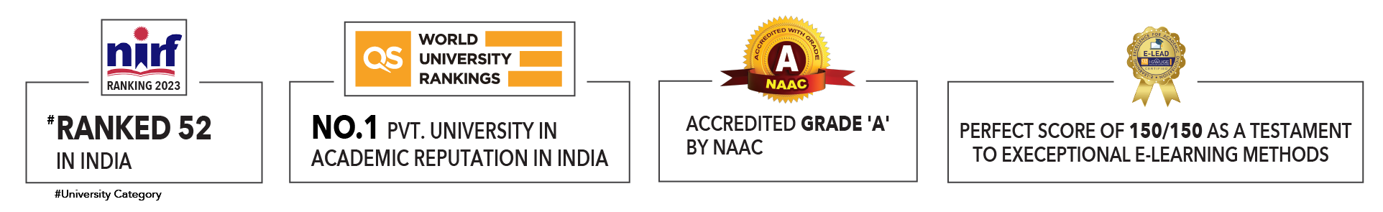

Slide 2

Unit 5 : Applications of AI and machine learning
Lecture 4: Retail and Supply Chain
School of Computer Science UPES, Dehradun
India

Slide 3
Table of Contents
Classification
Importance of AI in retail and supply chain
AI applications in retail
AI applications in supply chain
Retail case studies
Traffic prediction model
Route optimization algorithm
Summary
MCQ’s
References

Slide 4
Learning & Course Outcomes
LO1: Explore AI applications in retail and supply chains.
LO2: Design traffic prediction model.
LO3: To evaluate route, optimize algorithm.
CO2: Explore the data analysis and preparation techniques, the logic of AI algorithms for solving practical problems.

Slide 5
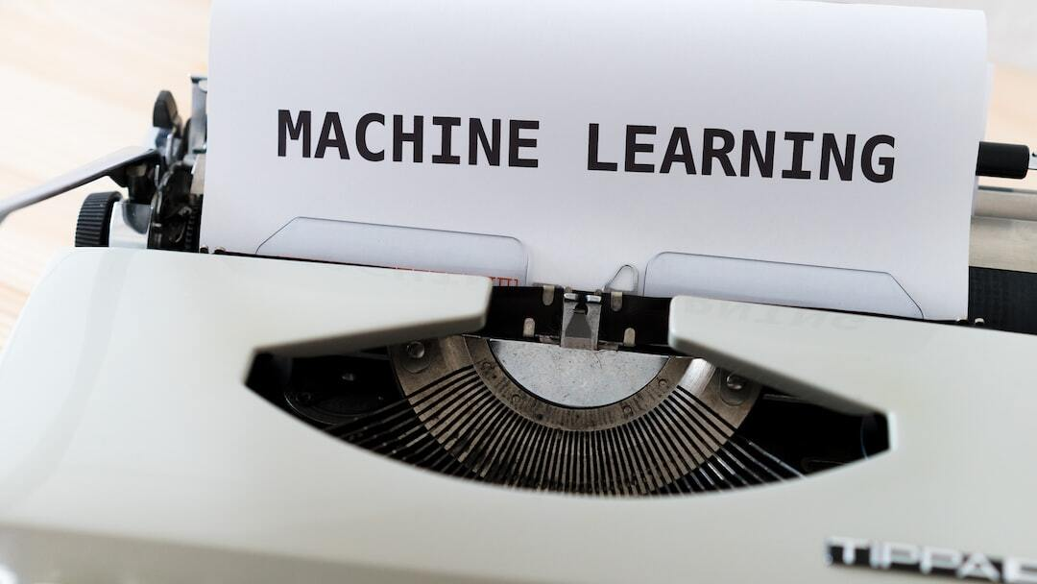
Retail and Supply chain
Overview of AI and ML:
AI: Simulation of human intelligence by machines
ML: Subset of AI focusing on data-driven learning
Importance in Retail and Supply Chain:
Enhances efficiency and accuracy Drives customer satisfaction and profitability

Slide 6
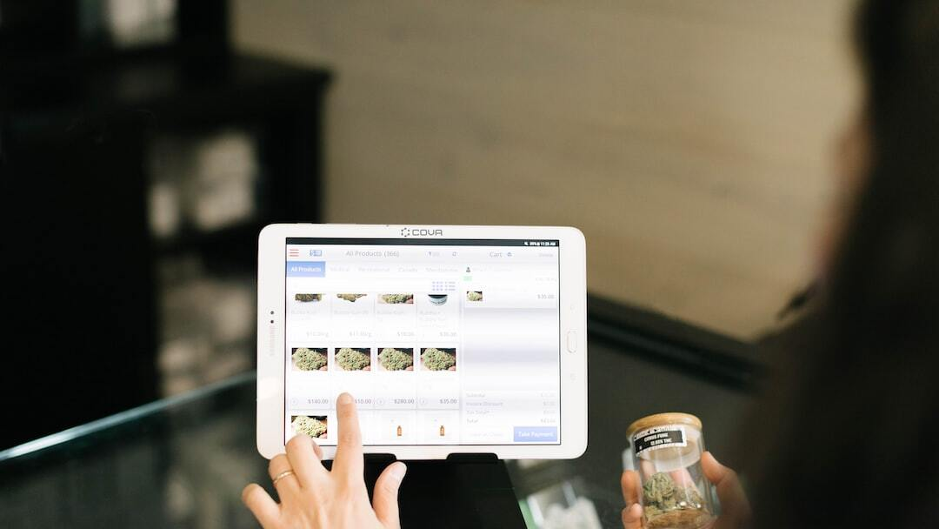
Retail and Supply chain
AI Applications in Retail
Customer Insights and Personalization: Analyzing customer data to offer personalized
recommendations Improving customer engagement and sales
Inventory Management: Predicting stock levels to minimize
overstock and stockouts Optimizing inventory turnover rates
Chatbots and Customer Service:
Providing 24/7 customer support
Handling common queries and enhancing user experience Fig 1: Retail application
Predictive Analytics: Forecasting trends and customer behavior Driving strategic decision-making

Slide 7
Retail and Supply chain
AI Applications in Supply Chain
Demand Forecasting: Predicting future demand to adjust production and inventory Reducing waste and increasing responsiveness
Supply Chain Optimization: Streamlining processes and reducing costs Enhancing coordination across the supply chain
Logistics and Route Planning: Optimizing delivery routes for speed and cost Improving customer satisfaction with timely deliveries
Quality Control and Predictive Maintenance: Monitoring product quality in real-time Predicting maintenance needs to prevent downtime

Slide 8
Retail and Supply chain
Retail case study
Personalized Recommendations
=> Enhancing Customer Experience with AI
Overview:
Using AI to provide personalized product recommendations
Example: Recommendation system for an e-commerce platform
Approach:
Collaborative filtering and content-based filtering
Hybrid recommendation systems

Slide 9
Retail and Supply chain
import pandas as pd
from sklearn.model_selection import train_test_split
from sklearn.metrics.pairwise import cosine_similarity
# Load data
ratings = pd.read_csv('ratings.csv')
products = pd.read_csv('products.csv')

Slide 10
Retail and Supply chain
# Create user-product matrix
user_product_matrix = ratings.pivot(index='user_id', columns='product_id’, values='rating')
# Compute cosine similarity
user_similarity = cosine_similarity(user_product_matrix.fillna(0))
user_similarity_df = pd.DataFrame(user_similarity, index=user_product_matrix.index, columns=user_product_matrix.index)

Slide 11
Retail and Supply chain
# Recommendation function
def recommend_products(user_id, num_recommendations):
similar_users = user_similarity_df[user_id].sort_values(ascending=False).index[1:num_recommendations+1]
recommendations = []
for similar_user in similar_users:
products_bought = user_product_matrix.loc[similar_user].dropna().index
recommendations.extend(products_bought)
return list(set(recommendations))

Slide 12
Retail and Supply chain
# Example usage
user_id = 1
recommendations = recommend_products(user_id, 5)
print(f'Recommended products for user {user_id}: {recommendations}')

Slide 13
AI Applications in Logistics
Supply Chain Optimization: AI-driven tools for enhancing supply chain efficiency Reducing costs and improving coordination
Inventory Management: Real-time tracking and optimization of inventory levels Minimizing stockouts and excess inventory
Demand Forecasting: Using AI to predict future demand Improving planning and reducing waste
Warehouse Automation: AI-powered robots and systems for warehouse operations Enhancing speed and accuracy

Slide 14
AI Applications in Logistics
Traffic Prediction Model
=> Use of historical traffic data and weather conditions
=> LSTM (Long Short-Term Memory)
------------------------------------------------------------------------------------------------------------
import numpy as np
import pandas as pd
from keras.models import Sequential
from keras.layers import LSTM, Dense
# Load and preprocess data
data = pd.read_csv('traffic_data.csv')

Slide 15
AI Applications in Logistics
Traffic Prediction Model
data['time'] = pd.to_datetime(data['time'])
data.set_index('time', inplace=True)
data = data.resample('H').mean().fillna(method='ffill')
# Prepare training data
def create_dataset(data, time_steps=1):
X, y = [], []
for i in range(len(data) - time_steps - 1):
X.append(data[i:(i + time_steps), 0])
y.append(data[i + time_steps, 0])
return np.array(X), np.array(y)

Slide 16
AI Applications in Logistics
time_steps = 24
X, y = create_dataset(data.values, time_steps)
X = X.reshape(X.shape[0], X.shape[1], 1)
# Build LSTM model
model = Sequential()
model.add(LSTM(50, return_sequences=True, input_shape=(time_steps, 1)))
model.add(LSTM(50))
model.add(Dense(1))
model.compile(optimizer='adam', loss='mse')
# Train the model
model.fit(X, y, epochs=50, batch_size=32, verbose=1)

Slide 17
AI Applications in Logistics
Route Optimization Algorithm
=> Importance of optimizing routes for logistics and transportation
=> Use of AI and heuristics to find optimal routes Example: Dijkstra's algorithm for shortest path
import heapq
def dijkstra(graph, start):
queue = [(0, start)]
distances = {node: float('inf') for node in graph}
distances[start] = 0

Slide 18
AI Applications in Logistics
while queue:
current_distance, current_node = heapq.heappop(queue)
if current_distance > distances[current_node]:
continue
for neighbor, weight in graph[current_node].items():
distance = current_distance + weight
if distance < distances[neighbor]:
distances[neighbor] = distance
heapq.heappush(queue, (distance, neighbor))
return distances

Slide 19
AI Applications in Logistics
# Example graph
graph = {
'A': {'B': 1, 'C': 4},
'B': {'A': 1, 'C': 2, 'D': 5},
'C': {'A': 4, 'B': 2, 'D': 1},
'D': {'B': 5, 'C': 1}
}
start_node = 'A'
print(dijkstra(graph, start_node))

Slide 20
Summary
The presentation focuses on the applications of AI and machine learning (ML) in the retail and supply chain sectors. It explores various aspects such as the significance of AI in these domains, specific applications, case studies, and technical implementations. AI and ML are transforming transportation and logistics by enhancing efficiency, reducing costs, and improving safety. Key applications include traffic prediction, route optimization, supply chain optimization, and warehouse automation.

Slide 21
Future Trends
Future trends include further integration of AI with IoT, advanced autonomous vehicles, and real-time supply chain visibility. Challenges include data privacy concerns, the need for robust infrastructure, and addressing ethical considerations.

Slide 22
MCQ’s
What is one of the primary uses of machine learning in retail?
A. Enhancing physical store layouts B. Predicting customer purchasing behavior C. Managing employee schedules D. Designing product packaging
2. Which AI technique is commonly used in retail to recommend products to customers?
A. Decision Trees B. K-Means Clustering C. Collaborative Filtering D. Linear Regression

Slide 23
MCQ’s
3. How can machine learning improve inventory management in retail?
A. By automating checkout processes B. By predicting stock levels based on historical sales data C. By enhancing customer service interactions D. By creating promotional content
4. Which application of AI in retail focuses on personalizing the shopping experience for customers? A. Automated checkout systems B. Dynamic pricing models C. Customer segmentation D. Fraud detection systems

Slide 24
MCQ’s
5. What is a significant benefit of using AI for dynamic pricing in retail?
A. It ensures all products are sold at the same price B. It helps retailers respond to market demand in real-time C. It simplifies the return process for customers D. It standardizes prices across different locations
6. What is the primary advantage of using LSTM networks over traditional RNNs (Recurrent Neural Networks)?
A. LSTMs are easier to implement B. LSTMs can handle long-term dependencies better C. LSTMs require less computational power D. LSTMs always provide higher accuracy

Slide 25
MCQ’s
7. Which component of an LSTM network is responsible for deciding what information should be kept or discarded from the cell state?
A. Input gate B. Output gate C. Forget gate D. Activation function

Slide 26
MCQ’s
1. Answer: B. Predicting customer purchasing behavior
2. Answer: C. Collaborative Filtering
3. Answer: B. By predicting stock levels based on historical sales data
4. Answer: C. Customer segmentation
5. Answer: B. It helps retailers respond to market demand in real-time
6. Answer: B. LSTMs can handle long-term dependencies better
7. Answer: C. Forget gate

Slide 27
References
https://scikit-learn.org/stable/modules/cross_validation.html
https://scikit-learn.org/stable/supervised_learning.html
https://scikit-learn.org/stable/modules/preprocessing.html
https://scikit-learn.org/stable/modules/model_evaluation.html
https://imbalanced-learn.org/stable/under_sampling.html
"Pattern Recognition and Machine Learning" by Christopher M. Bishop
"An Introduction to Statistical Learning: With Applications in R" by Gareth James, Daniela Witten, Trevor Hastie, and Robert Tibshirani
"Feature Engineering for Machine Learning: Principles and Techniques for Data Scientists" by Alice Zheng and Amanda Casari

Slide 28

Thank You

